Slide 1
COPS Training – Tidal Jobs

Slide 2

New Terminology
New Day Claims: claims that are coming today
Recycle Claims: claims from previous days
Oracle (SQL Developer): like MS SQL (what we use to run queries against other databases not on Facets), but connects to Facets so we can run queries against Facets

Slide 3
Previously
XC Load
Clearinghouses and 3rd party Vendors/Partners send 837 files containing claims to SFTP
Axway picks those files up and delivers them to their respective Production Location
837 files go through OTVM
Accepted files (HIPAA Compliant) files are staged for PEGA CIRT process
Claims are loaded into EDINET1P database. CIRT and Business Rules (ICP) are applied here.
Keywords are generated for the new day claims
Claims are loaded into FACETS_XC
Claims are loaded into GBD FACETS
Clearinghouses and 3rd party Vendors/Partners send 837 files containing claims to SFTP
Axway picks those files up and delivers them to their respective Production Location
837 files go through OTVM
Accepted files (HIPAA Compliant) files are staged for PEGA CIRT process
Claims are loaded into EDINET1P database. CIRT and Business Rules (ICP) are applied here.
Keywords are generated for the new day claims
Claims are loaded into FACETS_XC
Claims are loaded into GBD FACETS
CLMU Load
ODW Nightly Load picks up claims
EIDS Jobs pick up claims

Slide 4

CLA303B INBOUND PROCESSING
Breakdown of what CLA303B does:
CLA303B kicks off a process that moves 837 files into hot folder for OTVM to pick up
What does this relate to? OTVM and PEGA Staging
When does it start? 12:30AM
How often does it run? It runs throughout the day until 11:45PM
What does it do?
It takes 837 files from the vendor dropoff locations and moves them to CIFT/CIRT pickup locations
Note: Different vendors have different rules for compliance, OTVM checks each file based on its vendor.
Main locations to check: OTVM Error queue, OTVM Outbound Queue, Inbound Balancing Report
Once the files pass through OTVM, CLA303B will place them in the OTHER location.
Then, CLA303B moves the HIPAA compliant files from OTHER to Staging (meaning these files are staged to load to PEGA)

Slide 5
An Overview with Tidal Jobs
Clearinghouses and ^{3rd} party Vendors/Partners send 837 files containing claims to SFTP
Axway picks those files up and delivers them to their respective Production Location
837 files go through OTVM
Accepted files (HIPAA Compliant) files are staged for PEGA CIRT process
MGFT
CLA303B
CLA303B
Claims are loaded into EDINET1P database. CIRT and Business Rules (ICP) are applied here.
Keywords are generated for the new day claims
Claims are loaded into FACETS_XC
Claims are loaded into GBD FACETS
CLA303D
CLA303E
New Day: CLA305C, CLA305A
Recycle: CLA305B
CLA002
CLA004A
CLA002B
CLA002B_0020
CLA005_0010
CLA015_0010

Slide 6
The path of the 837 file through OTVM
Vendor Location (Dropoff)
CIFT/CIRT Pickup Location (Listener)
OTVM Hot Folder (OTHER)
Staged for PEGA (Staging/ PEGA Listener)
Prod Location (EDINET1P)

Slide 7
OTVM Statuses
New - file available, recognized it needs to be updated to be processed
Updated for processing - still in hot folder, file name is updated with .processing extension (meaning it will be picked up)
Waiting for Analysis - staged to be analyzed, but not in hot folder
Analysis in progress - currently going through OTVM with all the rules/policies/exclusion rules applied based on input queue
Analysis complete - file has gone through all rules and policies applied, prepped for error or report generation depending on whether all claims in the file are rejected or not
Error - trash status. Any files that fail to meet structural compliance or files that were abandoned during analysis will have this status. If any are shown with data, research further to identify cause of error
Generating Reports - creating necessary 277, 999s, submitter reports, and newly processed main file
Report Generation Complete - used in the output queue to go to the respective file location in prod

Slide 8
PEGA Load- New Day and Recycle Claims
The PEGA load is the process of loading claims into EDINETCLAIM on EDINET1P
Claims are loaded into 837 tables by the T837 Mapping application
This is monitored on the PEGA dashboard: https://30.96.14.28:8517/prweb/PRServletLDAP1

Slide 9
CLA303D, CLA303E, CLA301B – PEGA Load
The jobs that load the claims are:
CLA303D
Starts at 1AM and runs throughout the day until 5PM
Loads new day claims to PEGA
CLA303E
Starts at 5:15PM
Relies on CLA303D
Loads new day claims to PEGA
CLA301B
Starts at 9PM
Loads recycle claims to PEGA

Slide 10
Keywords
A flat file containing claims data that is loaded into Facets
An ETL process that takes claims data from EDINET Staging tables and puts them into Facets proprietary format (TriZetto format)
Keyword files do not include rejected claims from the 837 files.
Keywords are generated from EDINETCLAIM_PROCESS database on EDINET1P and loaded to FACETS through the XC00 Batch job and CLMU loads.
To check for the number of keywords generated for New Day claims, click on the "Keyword Status" page in the T837/CIRT (PEGA) Dashboard as shown in the next slide.
Note: the screenshot may look different than what you may see on your end.

Slide 11
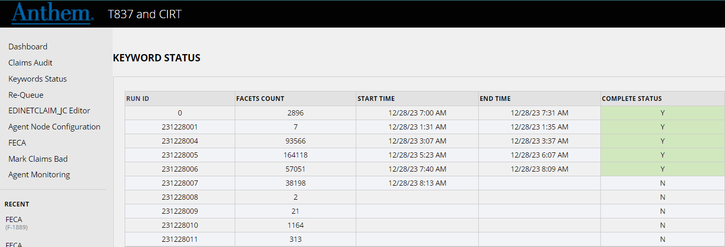
Keyword Status Page

Slide 12
CLA305C & CLA305A – New Day Keywords
These are the jobs that kick off Informatica processes which generate the keywords.
CLA305C – First New Day Keyword Job
Responsible for generating New Day claims
Starts between 1:30 AM – 6:45 AM
Depends on CLA303A = Completed Normally
CLA305A – New Day Keyword, runs throughout the day
Responsible for generating New Day keywords
Starts between 7:00 AM – 11:30 PM
Depends on CLA305B = Completed Normally

Slide 13
CLA305B – Recycle Keyword & CLA305D – Adhoc Keyword
CLA305B
This Tidal job is responsible for kicking off the Informatica process to generate the keyword for recycle claims.
Time dependency of 6:00AM – 8:30AM
CLA305D
Sometimes, we have a need to generate a keyword from a previous day or fix a New Day keyword.
In this case, COPS SME will request this job be inserted into the current day's schedule.

Slide 14
CLA002 – the first XC00 Batch Load
Starts at 10:30 AM Monday - Friday
Kicks off the process that loads claims from EDINETCLAIM on EDINET1P into FACETS_XC (staging database on FAC1P) by loading keywords.
Loads all keywords generated by CLA305C, CLA305B, and CLA305A by 10:30AM into FACETS_XC
Once this process completes, keywords are staged to be moved into GBD Facets
During and after this load, claims are still being loaded to PEGA by CLA303D, and keywords are still being generated by CLA305A.

Slide 15
CLA002B "The Primary" - CLMU Batch Load
Starts at 12:15 PM Monday - Friday
Adjudicates and loads claims from FACETS_XC to GBD Facets
Kicks off the second XC00 Batch load, taking keywords that have been generated since the first XC00 Load (CLA002) at 10:30 AM.
Runs the incremental CLMU Load
Takes all the keywords that have been loaded to FACETS_XC by the two XC00 Loads, adjudicates, and loads the keywords into GBD Facets

Slide 16
CLA004A – third and final XC00 Batch Load
Starts at 8:00 PM Monday - Saturday
Kicks off the third and final XC00 Batch load, taking keywords that have been generated since the second XC00 Batch Load (CLA002B) at 12:15 PM.
Does the same thing as CLA002

Slide 17
CLA005 "The Cleanup" - CLMU Batch Load
Scheduled for 6:45PM Monday – Friday
Adjudicates and loads pended claims from previous days into GBD Facets, then adjudicates and loads claims from FACETS_XC (claims loaded via CLA004A) to GBD Facets
This job has many more steps than that of CLA002B, and it will be reviewed in detail later.

Slide 18
CLA015 "The Cleanup" - CLMU Weekend Cleanup
Scheduled for 7:00PM Saturday & Sunday
Cannot run during deployments/maintenances occurring on Saturday and Sunday
Adjudicates and loads pended claims from previous days into GBD Facets, then adjudicates and loads claims from FACETS_XC (claims loaded via CLA004A) to GBD Facets
Does the same thing as CLA005, just on Saturday and Sunday. CLA005 does NOT run on the weekends.

Slide 19
CPC009A, B, and C - CKMM
Responsible for kicking off payment processing
CPC009A – Weekday CKMM job (M-F)
CPC009B – Saturday CKMM job
CPC009C – Adhoc CKMM job (only inserted into schedule as needed)
CLA005 (Cleanup) should be killed to allow the payment job to run.
Note: we care more about making the day's payments on the claims we've loaded rather than having the claims delayed by one day in getting loaded to Facets

Slide 20
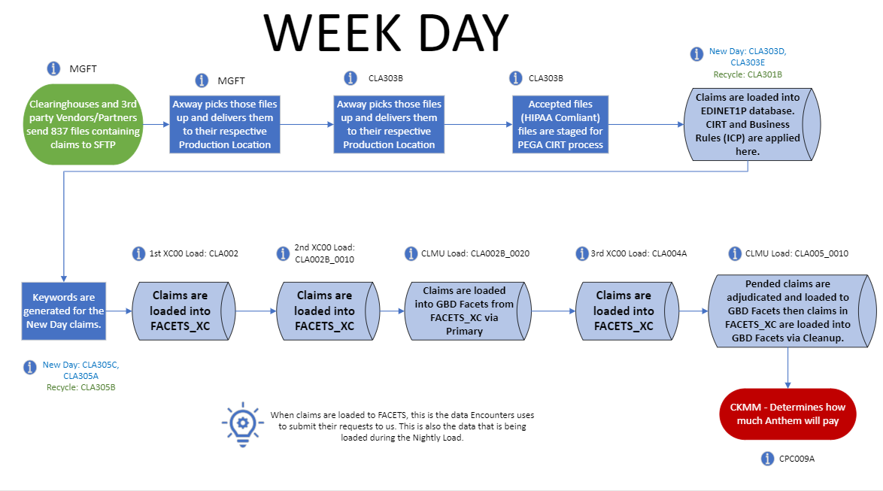

Slide 21
